Slide 1

Cyber Awareness
Build a digital game that raises cyber security awareness in our business teams
StrathHack26

Slide 2
Powering a cleaner, smarter future
We’re ScottishPower, part of the Iberdrola Group.
We help build a cleaner electric future through renewable energy, smarter networks and digital tools for customers.
GENERATE
Renewable energy from onshore and offshore wind.
CONNECT
Electricity networks connecting homes, businesses and communities.
SUPPORT
Energy services and digital tools that help customers take control.
465 people joined our early-career routes in 2026
This weekend: your code. Our cyber challenge.
Build a digital game that helps our colleagues understand cyber security.
Notes:
[Sources]
ScottishPower About Us: https://www.scottishpower.com/about_us
ScottishPower Our Businesses: https://www.scottishpower.com/about_us/our_businesses
ScottishPower, “Our biggest ever early careers intake,” 15 Sep 2026: https://www.scottishpower.com/w/our-biggest-ever-early-careers-intake
ScottishPower Careers: https://www.scottishpower.com/people_careers/careers
[/Sources]

Slide 3


The Challenge
Digital Innovation & Culture
We have a proven tabletop game that is used at graduate onboarding events and in some team training sessions.
We believe there’s a much bigger digital opportunity.
The list of cyber defences, rules, decisions and scoring are already in place. The challenge is to turn the physical experience into a game that is engaging, accessible and ready to scale.​​
We’d also love you to find a way to fold a set of cyber security behavioural questions, which currently form a separate quiz, into the game as a core element.
​

Slide 4
Cyber Security Knowledge Not Required
No Cyber knowledge is needed for this challenge.
All the content is written by our Cyber team. You bring the software and game design. Build the core game or stretch your ambition and take on some of the extra elements below
The Current Core + Minimum Required Addition
Level Up Gameplay
Increase Capability
18
controls, costed and scored
40
Cyber behavioural questions
3
Ready-made game themes with assets
4
Optional stretch capabilities
+

Slide 5

Foundation: Digitise the current table-top game
Digital Innovation & Culture
The game is set in a fictional energy business (feel free to be creative with the name). Players get a budget of £3 million to spend on cyber defences, all chosen before the attack starts. A realistic cyber attack then plays out across 4 phases, revealing which defence solutions score the most in each phase.
How to Play the Game
The game is played by a team. Each team chooses between ways to Prevent, Detect and Respond to cyber-attacks from provided control cards.
The Prevent, Detect and Respond cards each describe a particular cyber defence solution and its corresponding cost to implement.
Rules
Use the control cards to discuss and agree which controls to put in place before the attack starts, to keep the company as secure as possible within the £3m budget. You must choose at least one Prevent, one Detect and one Respond control, and you can choose more. Then watch the attack unfold: each phase reveals how many points your controls score. After each phase, a behaviour checkpoint asks questions, with extra points for secure answers. Your final outcome combines both.
Phase 1
Delivery
A convincing email. Someone clicks.
Phase 2
Discovery
The attacker explores while almost nobody is watching.
Phase 3
Command and control
A call from "IT" asks the night desk for an MFA code.
Phase 4
Encryption and ransom
Files are locked just before the day shift.
Notes:
About 35 seconds.
The attack starts on a Monday afternoon with a convincing email. Someone clicks. Overnight the attacker explores the network. At half three in the morning someone rings the night desk pretending to be IT and asks for an MFA code. And just before the day shift, the files are locked.
At every step there are two people questions: a bigger decision about the incident, and an everyday check, like what to do with a USB stick you find in the car park.
The timing is realistic. Most ransomware is launched out of hours, when fewer people are watching.

Slide 6
Foundation: The extra behavioural element
Digital Innovation & Culture
The controls game gets players to think about Cyber attack scenarios and teaches them a little about some of the ways in which an organisation can defend against them. But as individuals, there are key behaviours we’d also like to teach. A bank of 40 questions with 4 tiers of difficulty provides a way of measuring behavioural knowledge and awareness. Build them into the game, in your own way, as a behaviour checkpoint at the end of each phase. Secure answers earn extra points, and the final outcome after phase 4 combines these with the control score. Keep each checkpoint short: 30 seconds a question, or 2 minutes for the set.
Cyber Awareness Question Bank
Purpose | 40 behaviour-based induction scenarios with one clear correct answer per question.
Tier 1 | Spot the Risk | Recognise an obvious risk or warning sign.
Tier 2 | Read the Signs | Notice context, clues and unsafe workarounds.
Tier 3 | Choose Your Response | Apply a secure behaviour in a realistic workplace situation.
Tier 4 | Pressure Test | Maintain secure behaviour under trust, urgency, authority or social pressure.
Categories | 10 categories | Phishing; Passwords; MFA; Vishing & Smishing; QR & Mobile; Social Engineering; Physical Security; Safe Data Handling; Online Safety; Remote Working
Answer model | One clear correct answer | Incorrect responses are not treated as partially acceptable behaviours.
Notes:
About 40 seconds.
You choose a theme. The content and scores are the same in all of them; the theme changes how the game looks and feels. And every picture on this slide is a real model you get in the pack.
The Incident Room: the player lives through the attack in emails, chat messages, phone calls and updates, like a real employee would. It's the lowest-effort option because the artwork is supplied.
The Endurance Race: the business is a racing car. Every control you buy fits a part that does the same job. Multi-factor authentication is the immobiliser. Backups are the spare parts. The car that completes the most laps wins, and people decisions count double.
The Map Room: the business is a map of systems. You place your defences and watch the attacker's route. The key rule is that detection shows you the attacker; it doesn't stop them.
Or bring your own theme, and check it with us when we come round to your desk.

Slide 7
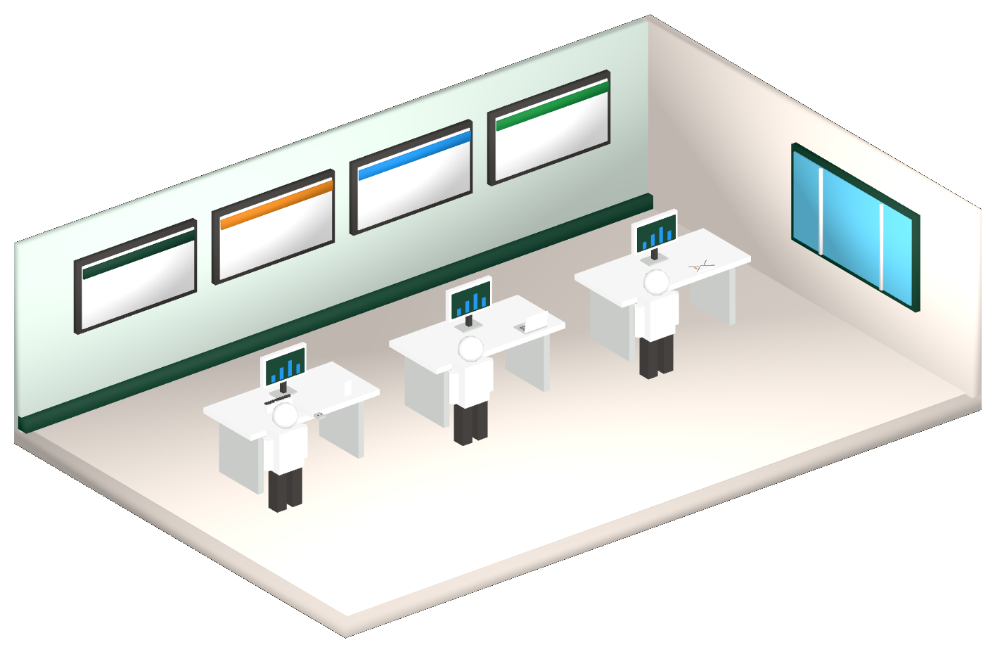
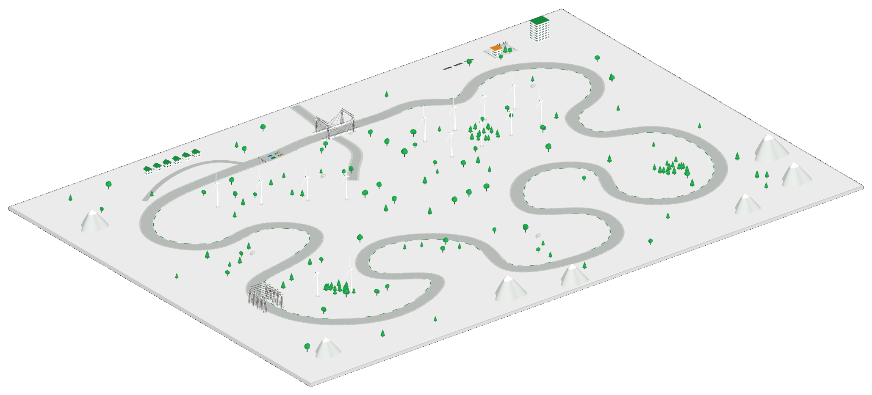
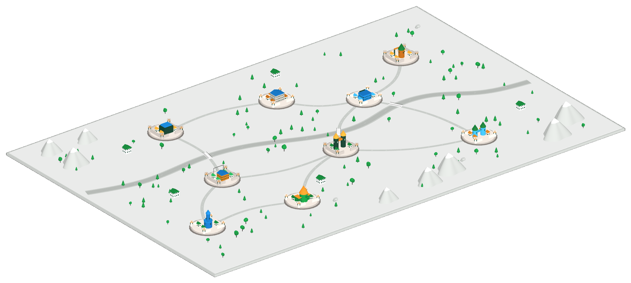
Extend: Themes to enhance gameplay experience
Digital Innovation & Culture
Choose one of our three ready-made concepts, or bring your own idea. We’ve provided some foundations. It’s up to you shape the experience, build and adapt it. Whether it’s related to the theme, the challenge or something else, you should also come up with your own name for the game.
The Incident Room
Live through the attack in emails, chat, calls and updates.
Effort: lower
The Endurance Race
The business is the car. Each control fits a part. Most laps wins.
Effort: medium
The Map Room
Place your defences on a map and watch the attacker’s route.
Effort: higher
Or choose your own theme. Check it with us when we visit your desk on Saturday.
Notes:
About 40 seconds.
You choose a theme. The content and scores are the same in all of them; the theme changes how the game looks and feels. And every picture on this slide is a real model you get in the pack.
The Incident Room: the player lives through the attack in emails, chat messages, phone calls and updates, like a real employee would. It's the lowest-effort option because the artwork is supplied.
The Endurance Race: the business is a racing car. Every control you buy fits a part that does the same job. Multi-factor authentication is the immobiliser. Backups are the spare parts. The car that completes the most laps wins, and people decisions count double.
The Map Room: the business is a map of systems. You place your defences and watch the attacker's route. The key rule is that detection shows you the attacker; it doesn't stop them.
Or bring your own theme, and check it with us when we come round to your desk.

Slide 8




Stretch: Add a capability
Digital Innovation & Culture
Add a major feature on top of the core game.
A Reactive questions
The controls players chose change the type and difficulty of the questions at each checkpoint.
B Multiplayer
Players on separate devices, one shared budget.
C Rewind & compare
Change a decision and compare the outcomes. A ghost car in the race.
D Scenario studio
Gives our cyber security team a no-code way to update the game in future with new scenario, prices and scores.
Higher risk
Highest risk
Lower risk
Medium risk
Notes:
About 35 seconds.
On top of the core game, you add a capability. They're ordered here by risk in the time you have.
Rewind and compare is the lowest risk, because our engine already records every action. Scenario studio and the game director are medium. The game director doesn't need an AI service: it picks what happens next from events our Cyber team has approved, and explains every choice. A world that reacts and multiplayer are the hardest, especially multiplayer, which needs a server and working wifi.
Most teams should aim for one capability, done properly.

Slide 9
What we’re giving you and what you’ll build
Digital Innovation & Culture
We give you | You build
The cyber content from our Cyber team | The game: every screen, interaction and piece of logic that isn't scoring
The scoring engine*, with tests | How your game drives the engine, stores and shows its state
40 behaviour questions, 16 linked to phases of the cyber attack story | How the questions fit the game and what the answers change
Three high-level game ideas | Your version of one of them, or your own idea
An artwork library in our house style, completely optional | How you use the artwork, or your own look if you have a strong idea
A demo page, a local server and a code example | Your own tests for everything you add
* The supplied engine covers the scoring for the cyber defence decisions teams make. It does not currently incorporate scoring for answers to the behavioural questions. If you update or replace the engine to include these, your game must give exactly the same scores for the existing elements, and your tests should be able to demonstrate that.
Notes:
About 35 seconds.
The attack starts on a Monday afternoon with a convincing email. Someone clicks. Overnight the attacker explores the network. At half three in the morning someone rings the night desk pretending to be IT and asks for an MFA code. And just before the day shift, the files are locked.
At every step there are two people questions: a bigger decision about the incident, and an everyday check, like what to do with a USB stick you find in the car park.
The timing is realistic. Most ransomware is launched out of hours, when fewer people are watching.

Slide 10


You can use AI tools
Digital Innovation & Culture
Use of AI coding tools is allowed on the challenge, and we generally expect teams to use them. We will be judging your thinking, technical solution design and problem solving.
You own
How the system is structured
Where the game state lives
Keeping the theme separate from the engine
What gets tested, and the trade-offs
Understanding and being able to explain the code you submit
You can use AI tools to help with
Writing the code
Interface components and styling
The tests you have designed
The repetitive parts
Architecture and design is 25% of the marks. Engineering and testing is another 25%.
Notes:
About 35 seconds. The most important slide.
Use AI coding tools. We'd be surprised if you didn't. What we want from you is the design: how the system is structured, where the game state lives, how you keep your theme separate from the engine, and what you test.
Half the marks are for architecture and testing, and we may ask any of you to explain any part of your code.
Design first, and merge your work often, so problems show up while there's still time to fix them.

Slide 11
Stick to the Foundation, Extend or Stretch the challenge
Digital Innovation & Culture
Level | What it means
Foundation | The core table-top game in a digital form: buying, all four phases, debrief, keyboard access. Plus your design record PLUS Design and add in a way for the behavioral question bank to be part of the game and scoring model
Extend | The full core game in a theme
Stretch | The full core game, themed, with behavioural questions PLUS one additional capability
A well implemented and fully working foundation can beat a game with multiple incomplete stretch capabilities
Notes:
About 30 seconds.
Three levels, and all three can win.
Foundation is the full core game in your theme. Aim for that by dinner on Saturday. Integrated adds one capability, by the time the venue closes. Complete adds a second one that works with the first, and it's a stretch.
We've set these by working out the real time you have. After lunch, dinner and setting up, it's about eight and a half hours of coding each. That's enough for Foundation and one capability, done well. So that's what we'd aim for.

Slide 12

How we will judge
Digital Innovation & Culture
Area | Marks
Architecture and design | 25
Engineering and testing | 25
Learning and cyber accuracy | 20
Player experience | 15
Communication and honesty | 15
Show it working
The core rules, one question answer changing the game and your theme.
Be honest about limits
Tell us what doesn’t work yet and where AI has helped
Explain a design decision and a test
We may ask anyone on your team.
Notes:
About 35 seconds.
Here's how we judge. Half the marks are architecture and testing.
On Sunday morning we visit your desk and do two things. We run your depth tests again with inputs you haven't seen, because AI tools are good at passing the tests you show them. And we hand you a new control card, with three minutes to get it into the game without touching engine code. After your presentation, we may pick a part of your code and a person, and ask how it works. Ambition earns up to five extra marks, but never more than quality: a polished core game can win.
Every theme also has to pass four checks, including that it gives the same scores as the standard game.

Slide 13


What you get
Something for everyone who enters
A ScottishPower Cyber goodie bag and written feedback on your submission.
Prizes for the top three
1st: Amazon vouchers. 2nd and 3rd: exclusive merchandise.
Individual performance
For anyone who demonstrates standout individual performance, we are able to recommend your name (if you wish) to our Year in Industry and Graduate programmes. This may assist any application you make.

